Slide 1
Lean + Agile = innovation?
Rune Hvalsøe
Section Manager
Sony Mobile Communication
agileblog.danskerne.se

Slide 2
Content
Creative vs. Innovation
Organizational dysfunction
Will Lean/Agile help?
How can Agile help?
The customer
Q & A
Thanks to Vinnova & Andreas Larsson
Notes:
I will add ”real life” stories from Nokia/Sony when possible.

Slide 3
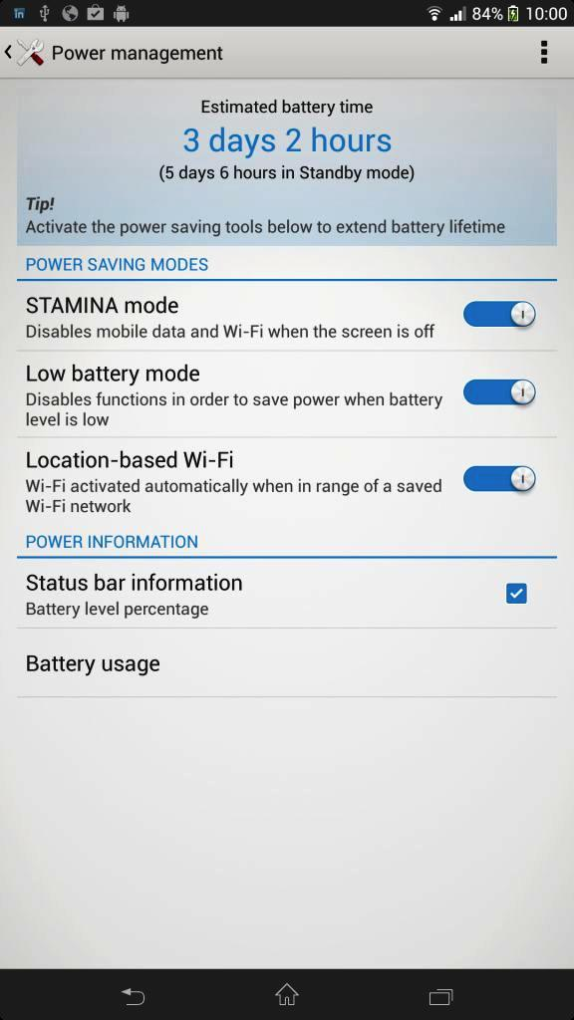
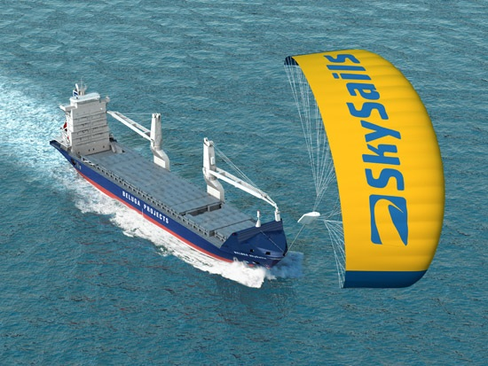
Innovation
Notes:
From UK I got the following definition:
creativity – ideas
invention – new ideas
innovation – delivery of new ideas.
An example of a extreme innovation is when you combine kite surfing and cargo shipment- launched December 17 2007 (160 m2 computer controlled sail)
A small but important mobile innovation at Sony is the Super Stamina feature
Radical innovations involve finding an entirely new way to do things. As such they are often risky and difficult to implement. Most larger organizations and most managers are poor at radical innovation. If you had been making LP records then you could have introduced incremental innovations in your design and marketing. However if this was your strategy then a radical innovation, the CD, would eventually kill you. The CD manufacturer could similarly introduce various incremental improvements. Once again a radical innovation, music downloads over the internet, would make your offering obsolete. So we need to constantly look for incremental innovations and radical innovations. We need to develop creativity and turn it quickly into innovation.
Innovation is the hardest.
Often we look in the wrong place for innovation because we think it is invention. We look to academia (who come up with new ideas) when we should look at the industry (who delivery new ideas).

Slide 4
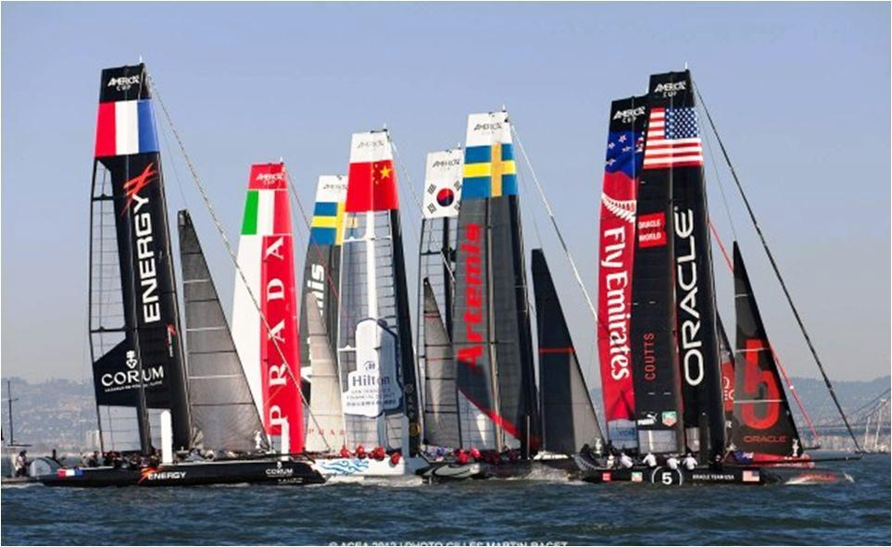
Organizational dysfunction
Notes:
It’s fantastic to be in a big company – you have a solid economic foundation and you don’t need to constantly think if you will have money for tomorrow or next month, but beeing a big company is also a threat – I like the analogy with
Titanic as the big company with all the safe feeling, but when they face a challenge that require that they act fast, they are not able to change fast enough – doesn’t have to be an iceberg, it could also be an opportunity
The alternative is a company with many individual companies inside, they are still a big company, which should help each other if needed, they will be able to navigate much faster and avoid danger and investigate opportunity and if anyone happens to crash, there is always someone around who can come to rescue them
The Titanic ship is the illustration when you create departments within the company who are responsible for the device driver, another for the call stack, another for the message applicaiton etc – you can put it together and create products – the problem is that the different departments have responsiblity of an area NOT a product! And when everyone is responsible for the progress – no-one is responsible... ☹
Example – Nokia in the early 2000 (until 2006?) – was a company of small groups, each delivering a finished product to the customers – still helping each others, but responsible for their own product
When I came back from Beijing in 2009 I saw a completelty different company, smal groups of people responsible for every product in their knowledge area, they were always behind, they never had the big picture – and I started to see a ”blame-game” taking place, i.e. as long as our department do what we are responsible for, we are not to blame, it is the others who failed and the company did not manage to deliver the product in time – and also I saw departments who never had time to investigate, be creative or innovate – there was always this huge backlog killing them... I saw really fantastic and very skilled developers stuggling with the work where they use to be super creative and on top of almost everything, what a shame and waste of talent... ☹
Nokia went Agile – and did manage to get some momentum out of this, but not enough to get the benefit from having groups focusing on products with time to innovate...
Yes – it is much more difficult to control a pool of boats than to navigate a huge company – but the results are so much better when you have a bunch of small companies within the company – you can still have the service organs to support the boats and you can have a CEO who is in the match official boat – giving directions etc.

Slide 5
Organizational dysfunction
Mark Parker (CEO at Nike, one of the most successfully innovative companies today) says “Companies fall apart when their model is so successful that it stifles thinking that challenges it….” (full story)
Prevent innovation
Notes:
Organizational dysfunction:
Often, the easiest way to identify how to create something is to look at how to prevent it from happening, so what would help to prevent innovation?
Unhealthy internal competition, silo thinking, blame game…
Bosses who reject ideas and kill innovation through fear and ridicule,
No way to handle innovative ideas (i.e. all must be approved and financed)
Protection Obsession,
No organization culture for innovation,
Poor process causing extra work,
Have a slow and ineffective process to handle innovative ideas
Nokia – 6 managers discussing 1h if a developer should use 2h to test an improvement idea

Slide 6
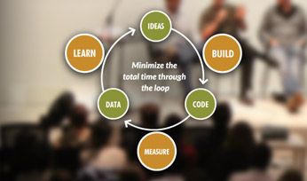
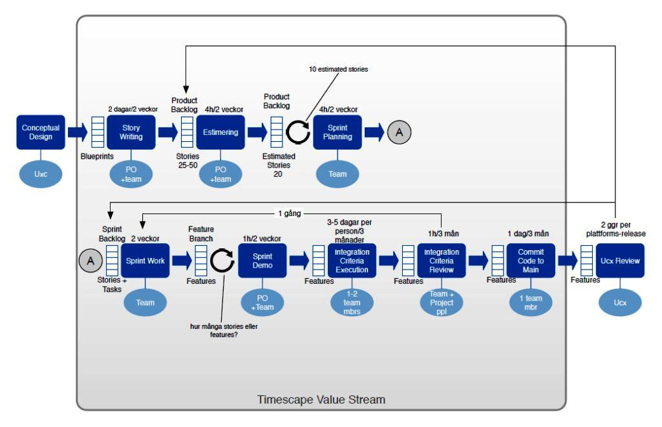
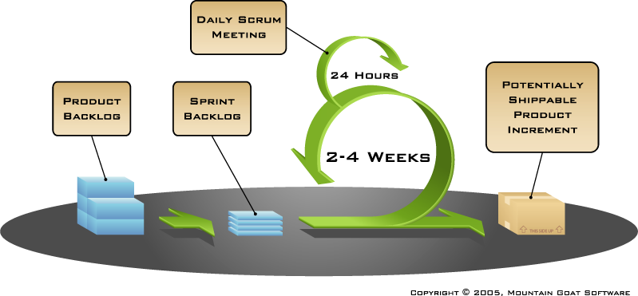
Will Lean/Agile help?
CTL
CTL
“Failing quickly is actually not that bad,” says CEO Jeff Immelt, a 31-year veteran of General Electric. “Failing slowly is deadly.”
Faster – Better – less waste – higher quality
Notes:
Agile isn't simply about spending less money, becoming faster, creating better quality...
Waterfall model – if we have an idea, we probably have to make a decision and discuss if we should start a 10M € project
It will require tuff decission and much more info
Xerox – Graphical interface – 1980 (around), Apple/Steve Jobs – pretty huge project that Xerox started, but without anyone who could dream the usage, but sold to cover (some?) of the cost
Agile can be used to test your assumptions
With Agile, we simply prototype it and check if it is working, we might need 5k€ to verify that it works, get fast feedback
Prototyping is innovation – it is delivery of new ideas
Failing fast, failing cheap (if it doesn’t work)
A comment that I heard ”Creativity costs less but Innovation requires huge investment with repect to time, efforts, money, manpower, energy, space etc etc.”
Use the fast feedback loop, CTL…
The purpose of test is to learn, if you test often and early, you will create a fast growing leaning curve.
Example:
Sony: Album globe – first implementation 0,01% - second about 1%, i.e. increase 100 times.

Slide 7
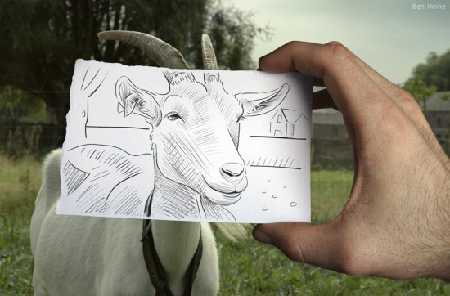
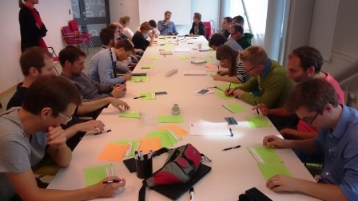
How can Lean/Agile help?
Playfull
Notes:
No Slack - Keep everyone busy 100% of the time with predefined work and constantly pushing them to deliver, high stress level
Have strict control of what you do, always have everything specified 100% -
Book Slack (Tom Demarco), is about to take away the right slack and create a framework for the team(s)
Remember people under pressure don’t think faster
Vision is important – if we use the boat analogy, the CEO have to guide and create a vision.
Empowerment – You only get strong engagement if you empower people.
Use time to create product uniqueness
Most of us don’t lean well from abstraction, we learn from example, we don’t learn well in isolation
Knowledge work is by definition collaborative
Nobody is going to succeed without taking chances – risk avoidance is everywhere
Pomodoro – one-man scrum – focus on what you do
Fika – Team thing, discussing private stuff and work stuff – this helps the team become a more tight team and helps to view things from different perspective - my IBM review tech.
Play full! - Make space for play full way of working, it can either be in the team where the team members love what they do so much that they start to challenge each other to create new things and explore ideas – Only strong teams think out of the box.
The team should be involved in creating the backlog! Empowerment!
Collaboration in the team and strong team spirit can move the team into this way of working, it does require that we have cross functional teams, we need different kind of people, i.e. both strong developers and strong graphical designers to create this environment
Great things in business are never done by one person – they’re done by a team of people (there is no I in “Team”).
Give the team some space - while you still get them to deliver things
Creative week 1 of 2 presentation – 2 of 2 is the innovation, i.e. delivery of the creative ideas that we have done…

Slide 8
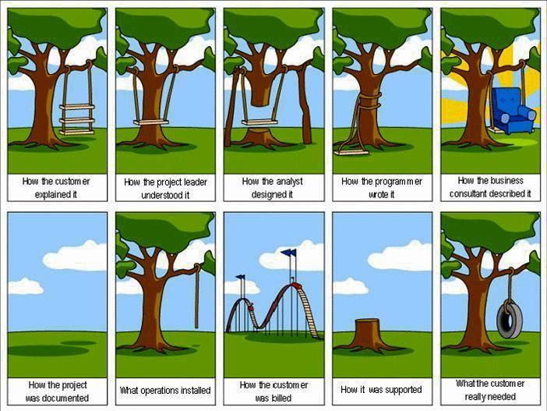
The customer
Notes:
Basic: Know your customer, if you don’t know your customer, you don’t know what quality is!
Give the team an understanding of how the customer think
- we are planning to visit a café one day with the team, so that they can watch the customers play with their or competitors products - to learn how they use them, for what purpose and what they would like to do with the tools - this will help them to create the right ideas when they (the team) contribute to the backlog...
Observe people in their natural surroundings
LTH testing – not only UX issues – but also learning to understand the end user.
The developers often read and interpret blue-prints – but if they don’t understand the customer, they will most likely miss-interpret things and if they don’t know the customer, they will not be able to create good ideas for the backlog…

Slide 9
Q & A
.....
.....
.....
agileblog.danskerne.se

Slide 10
Thanks to
Andreas Larsson for helping me creating the presentation – Andreas is Associate Professor, Innovation Engineering at Department of Design Sciences at Lund University, Faculty of Engineering
Vinnova (http://www.vinnova.se/sv/) – who have sponsored a research project which we used for inspiration

Slide 11
Reference
http://jamienotter.com/2012/04/the-feeling-of-failure/ - picture borrowed slide 5
http://givingsomething.com/blog/2012-02-15/eric-ries-lean-startup-action - picture borrowed slide 5
http://www.brainpickings.org/index.php/tag/flickr/ - picture borrowed slide 5
http://startupramp.typepad.com/ - picture borrowed slide 6
https://itunes.apple.com/au/app/titanic-iceberg-ahead/id569912770?mt=8
http://www.brandoncompany.com/2013/06/july-4-extravaganza-opens-the-summer-of-racing-for-americas-cup/
http://www.innovationexcellence.com/blog/2010/06/07/what-is-the-difference-between-innovation-and-creativity/
http://www.mountaingoatsoftware.com/ - Scrum picture

